Slide 1
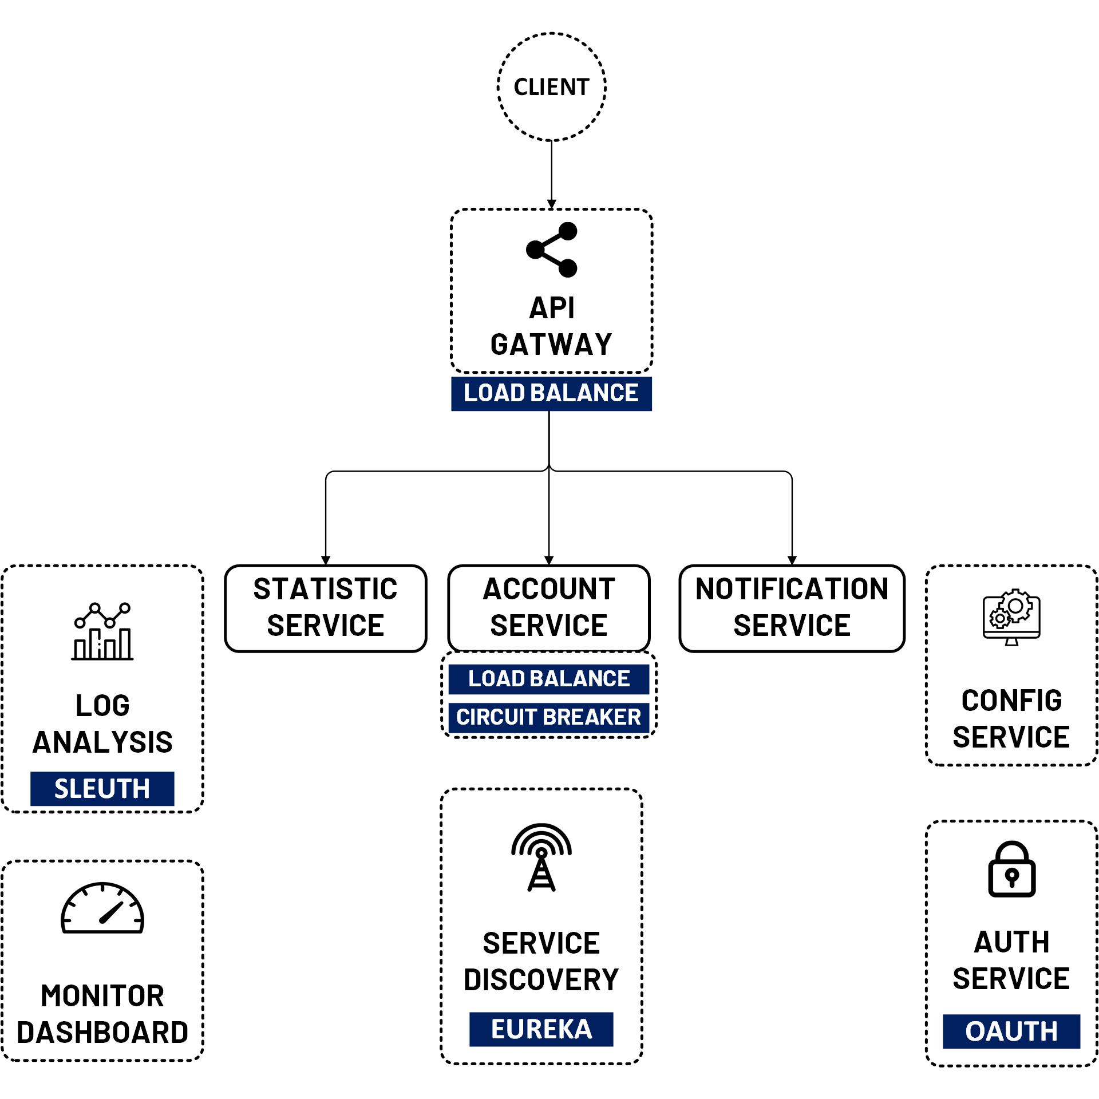

OAuth 2 Security Refresh Token
www.jmaster.io/course/microservices-with-spring-cloud

Slide 2
Refresh Token
The Refresh Token grant type is used by clients to exchange a refresh token for an access token.
This allows clients to continue to have a valid access token without further interaction with the user.

Slide 3
